Slide 1
Machine Learning:
Automate your Success in Stocks
By: Bailey Richterman, Alex Park, Dan Ladner, & Anthony Barone
Notes:
Dan

Slide 2
Executive Summary
The goal of our financial application was to allow the user to tell us their specific goals and to use that information to help build a recommendation (buy, sell, hold, etc.) for the user.
How this relates to Machine Learning and FinTech:
Used Ada Boost Classifier ML model
Used Logistic Regression
Research Question:
How well can we build out a predictive model that will provide the user with buy/sell/hold signals?
Notes:
Dan

Slide 3
ML Model
Ada Boost Classifier
SciKit Learn
Logistic Regression
Google Colab
Notes:
Bailey

Slide 4

Data Preparation
Notes:
Bailey
We had 2 steps to our data prep: the first is input from the user and the second is pulling in the actual data.

Slide 5
Data Preparation
User Input
What is your risk level?
What stock would you like to analyze?
Timeframe to reach your goal?
Notes:
Bailey
For our user input, we ask the user the following questions

Slide 6
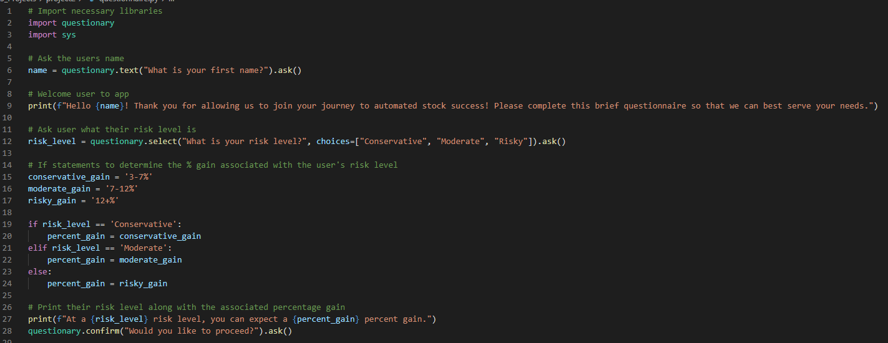
Notes:
Bailey
Here is a snapshot of our code asking our user the questions I previously laid out. You will notice we included an expected % gain associated with each risk level. The % gain are very generous, but allowed us to differentiate between the risk levels.

Slide 7
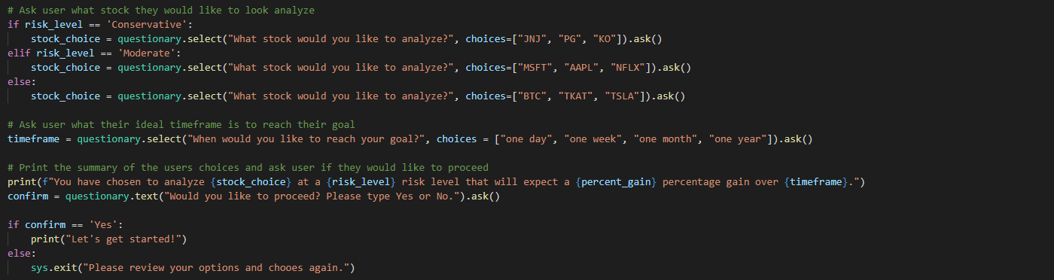
Notes:
Bailey
Final print line will summarize the users input and allow them to proceed or exit the program and start again.

Slide 8
Data Preparation
Pulling in the data
Import yfinance as yf
tickers = yf.Ticker(stock_choice)
df = pd.DataFrame(tickers.history(start=”2016-10-02”, end = “2021-10-07”, interval = “1d”))
df
close_df = close_df.dropna()
Notes:
Bailey

Slide 9

Our Approach
Allow a user to select an investment based on their risk tolerance.
Questionnaire
Output technical analysis based on their selection
RSI, SMA, MACD
Analyze their potential returns by running their input through our machine learning model to predict performance
Compare technical analysis data points with machine learning data
RSI over 70 / under 30.
MACD crossover points
Notes:
Anthony

Slide 10

Brief Demo
Notes:
Alex / Anthony

Slide 11

Conclusion
We were able to successfully create a program that uses 2 different ML models
The AdaBoost Classifier model performed better than the Logistic Regression model
Final step: created a pattern of buys/sells based on the signals we created (+/-1). Will help the user forecast and learn when to buy and sell
Notes:
Dan

Slide 12
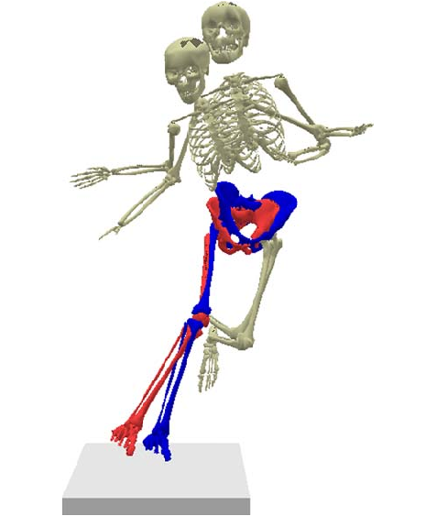
Unanticipated Issues/Insights
Questionnaire would not run in Google Colab
Integrating the user’s input with our machine learning models has proven to be difficult
Used a Google Colab form to select the user’s stock choice in the interim, but would like to build out the full questionnaire so that it is fully integrated
Wanted to include more NFT’s, but data is limited in timeframe and simultaneously overwhelming in content
Ran out of time and was not able to include our timeframe piece
Notes:
Dan

Slide 13


Next Steps
Chat Bot
Set up a chat bot that will give the user updates about the stock they have previously analyzed
Enhance predictive capabilities of our models
Classification reports could be stronger
Notes:
Dan

Slide 14

Data Sources / Repo
https://github.com/anthonybarone0211/project2
https://pypi.org/project/questionary/
https://finance.yahoo.com/
https://technical-analysis-library-in-python.readthedocs.io/en/latest/ta.html
Notes:
dan

Slide 15

Questions?
Notes:
Dan

